Slide 1
Anaphylaxis
By Thomas Tay
Adapted from Resuscitation Council UK

Slide 2
Definition
Anaphylaxis is a severe, life-threatening, generalised or systemic hypersensitivity reaction

Slide 3
Problem
Many patients with a genuine anaphylactic reaction are not given the correct treatment
Patients have been given injections of adrenaline inappropriately for allergic reactions just involving the skin, or for vasovagal reactions or panic attacks

Slide 4
How to recognise anaphylaxis?
Anaphylaxis is likely when all of the following 3 criteria are met
Sudden onset and rapid progression of symptoms
Life-threatening Airway and/or Breathing and/or Circulation problems
Skin changes (flushing, urticaria, angioedema)
The following supports the diagnosis
Exposure to a known allergen for the patient
Remember:
Skin and mucosal changes alone are not a sign of an anaphylactic reaction
Skin and mucosal changes can be subtle or absent in up to 20% of reactions (some patients can have only a decrease in blood pressure)
There can also be gastrointestinal symptoms (vomiting, abdo pain, incontinence)

Slide 5
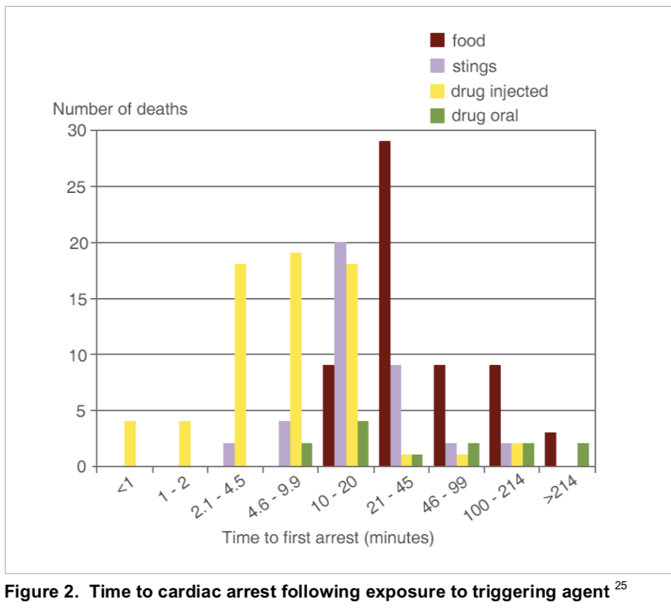
Sudden onset and rapid progression
The time of onset depends on the type of trigger
Fatal food reactions cause respiratory arrest typically after 30-35 mins
Insect stings cause collapse from shock after 10-15 mins
Deaths caused by IV medication occur most commonly within 5 mins

Slide 6
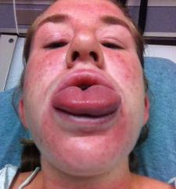
Life-threatening ABC problems
Airway problems:
Airway swelling eg. Throat and tongue swelling (The patient has difficulty in breathing and swallowing and feels that the throat is closing up)
Hoarse voice
Stridor

Slide 7
Life-threatening ABC problems
Breathing problems:
SOB
Increased RR
Wheeze
Patient becoming tired
Confusion caused by hypoxia
Cyanosis
Respiratory arrest
Anaphylaxis can present like an acute asthma attack with no other features of anaphylaxis

Slide 8
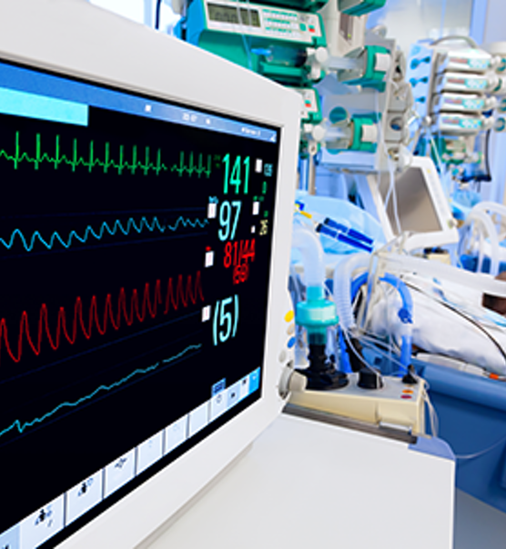
Life-threatening ABC problems
Circulation problems:
Signs of shock – pale, clammy
Tachycardia
Hypotension
Decreased conscious level or loss of consciousness
Bradycardia (late feature)
Cardiac arrest

Slide 9
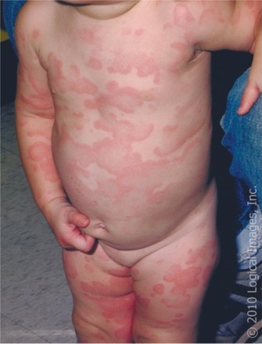
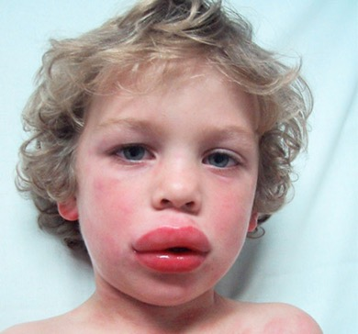
Skin changes
Urticaria/ wheals
Angioedema

Slide 10
Aetiology

Slide 11
Differential diagnoses
Life-threatening
Life-threatening asthma
Septic shock
Non life-threatening
Faint (vasovagal episode)
Panic attack
Breath-holding episode
Idiopathic (non-allergic) urticaria or angioedema

Slide 12
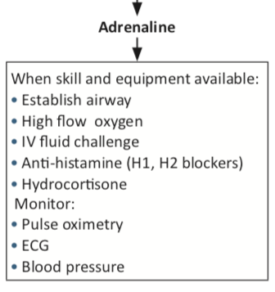
Management
Notes:
Remove allergens
IM adrenaline
IM/ slow IV antihistamine (chlorphenamine)
IM/ slow IV steroid (hydrocortisone)

Slide 13
Remove allergens

Slide 14
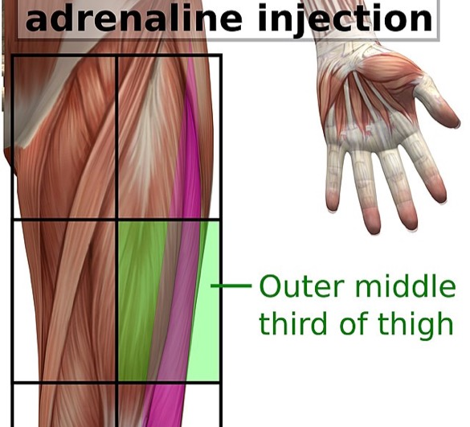
IM Adrenaline
Most important drug for the treatment of anaphylaxis
Mechanism
Bronchodilation
Vasoconstriction
Increases force of myocardial contraction
Suppresses histamine and leukotriene release
Should be given to patients with life-threatening features

Slide 15
Doses

Slide 16
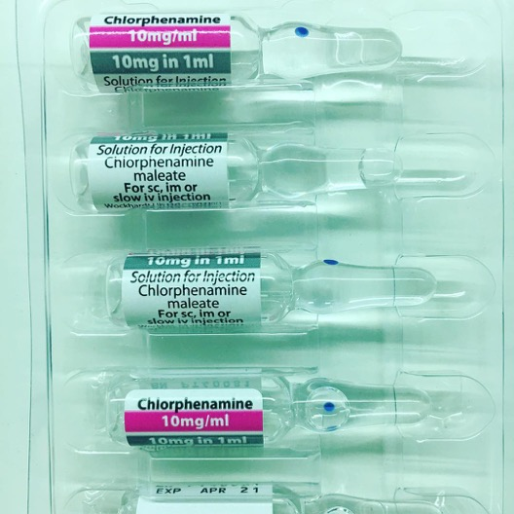
Antihistamines (after initial resuscitation)

Slide 17
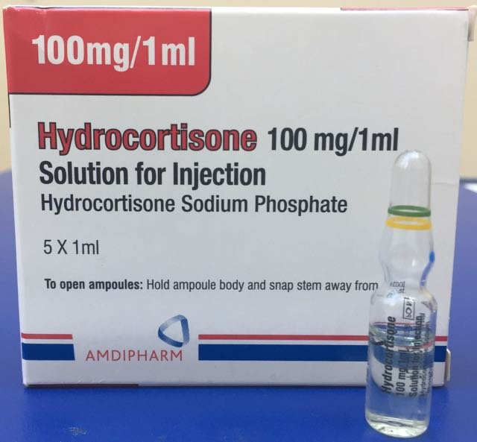
Steroids (after initial resuscitation)

Slide 18
Investigations
Usual investigations appropriate for medical emergency
ECG
CXR
U&E
ABG
Mast cell tryptase

Slide 19
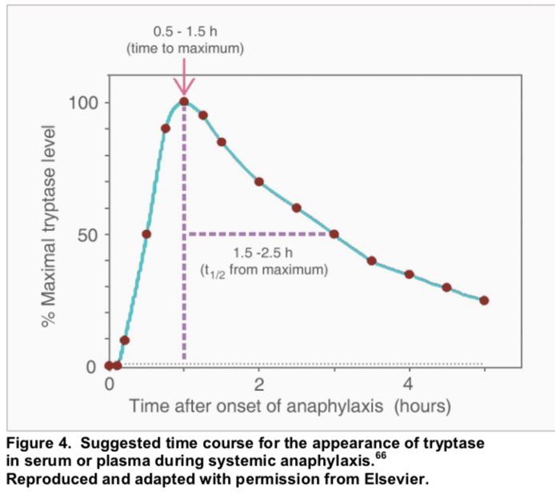
Mast cell tryptase levels
Tryptase is the major protein component of mast cell secretory granules
In anaphylaxis, mast cell degranulation leads to markedly increased blood tryptase concentrations
Tryptase levels are useful in the follow-up of suspected anaphylactic reactions, not in the initial recognition and treatment

Slide 20
Blood sample timing

Slide 21
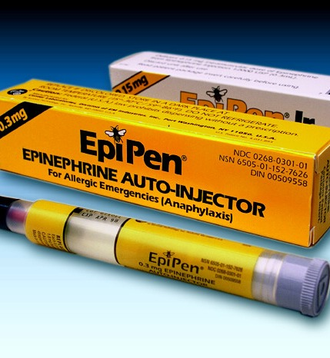
Adrenaline auto-injector
High risk of recurrence
Food trigger
Venom trigger
Not for drug trigger
Patient education on trigger avoidance + use adrenaline auto-injector

